Slide 1
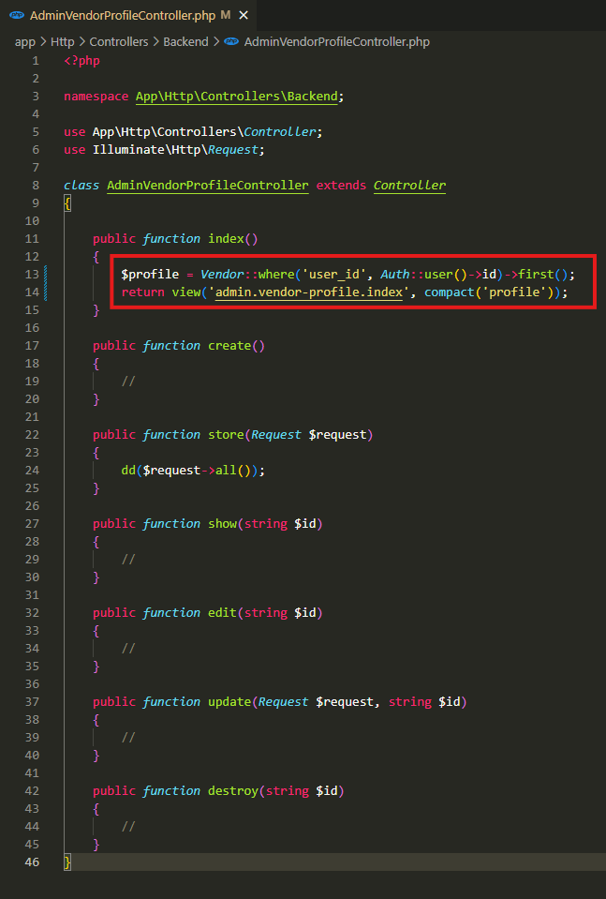
app\Http\Controllers\Backend\AdminVendorProfileController.php

Slide 2
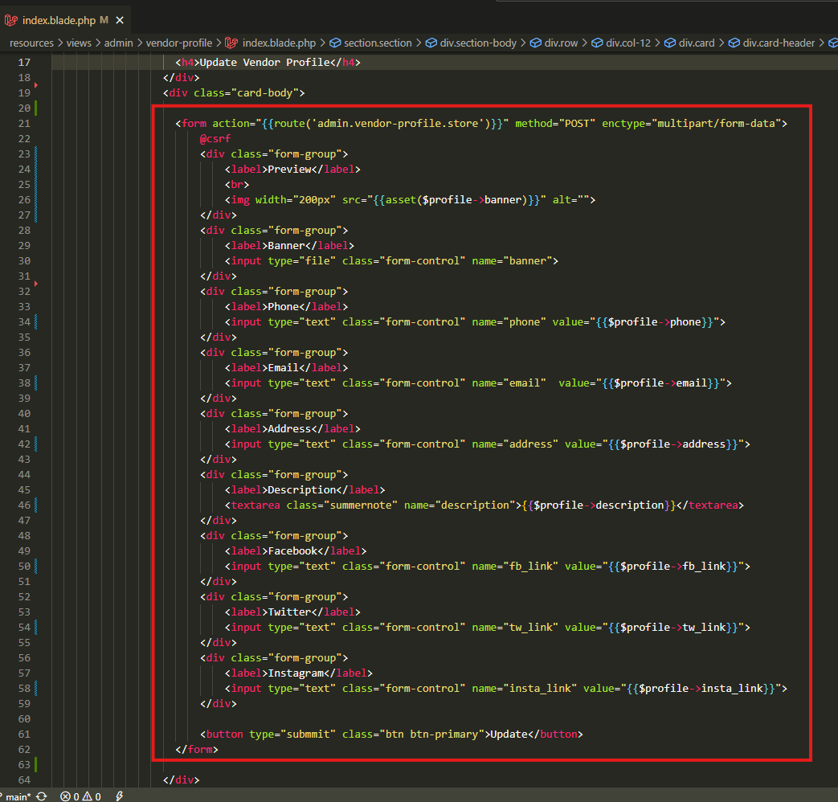
resources\views\admin\vendor-profile\index.blade.php

Slide 3
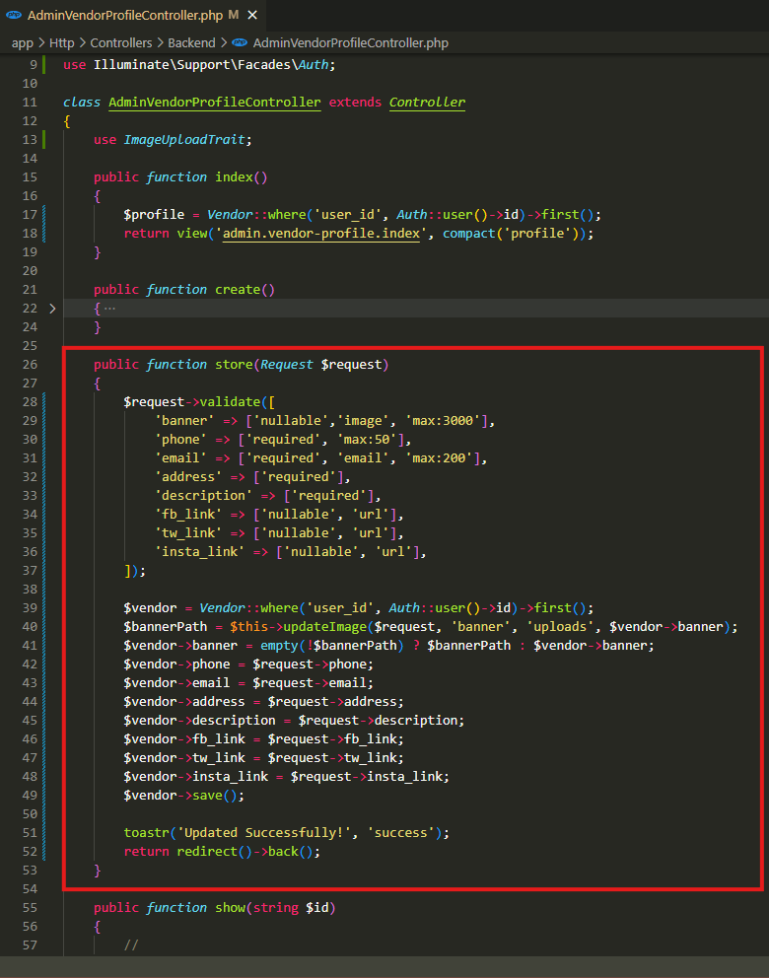
app\Http\Controllers\Backend\AdminVendorProfileController.php

Slide 4
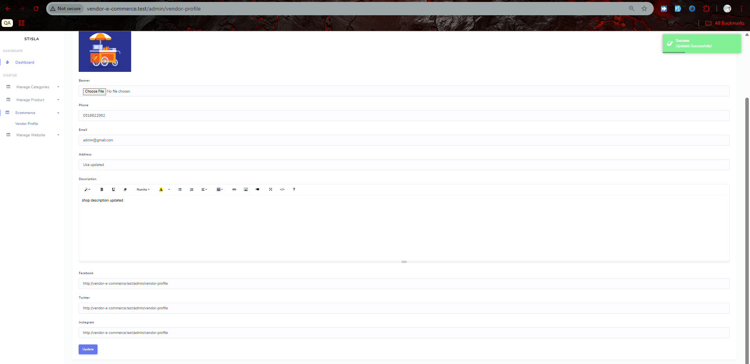
UPDATED

Slide 5
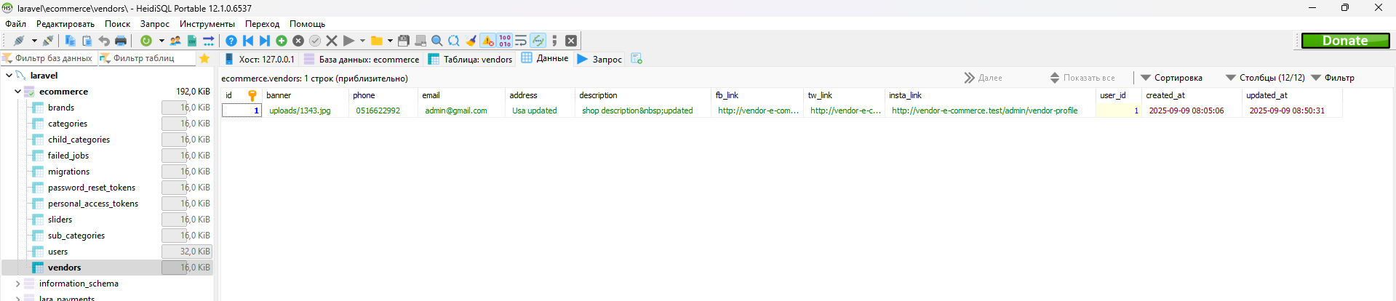
.

Slide 6
.

Slide 7
.

